Slide 1
Predicting Aging Inventory

Slide 2
INFERENCE
Dell has various products and they are lying in different 3rd party logistics we need to monitor the inflow, outflow, specs of different products and also keep a track of which product in how much quantity is lying in which 3pl.
We need to keep a track of number of days a particular product is lying in the inventory. If the duration is more than 90 days we need to suggest different ways to clear out the inventory.
We also need to predict that how many products of a kind will be sold in a particular period based on the previous selling pattern and how many will be left behind in the inventory after 90 days.

Slide 3
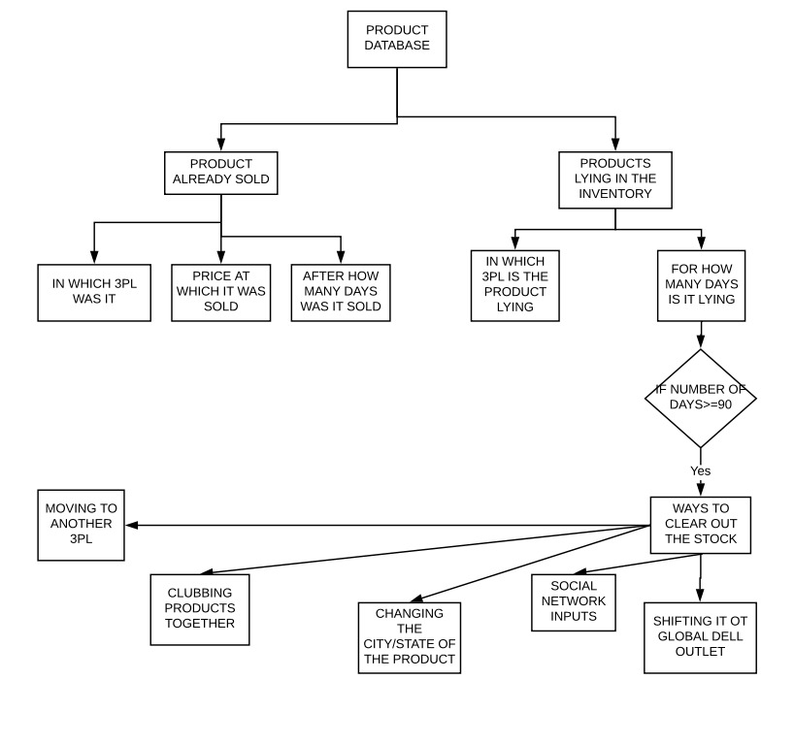
Flow Chart

Slide 4
POSSIBLE OPTIONS AND WAY FORWARDS
Suggestion of moving another 3PL.
"GDO sale": International sale of an item if it's not selling well locally.
Social network inputs to find right customer for these aging inventory.
Bundle up products.
Put a discount on that product.
Introducing flash deals.

Slide 5
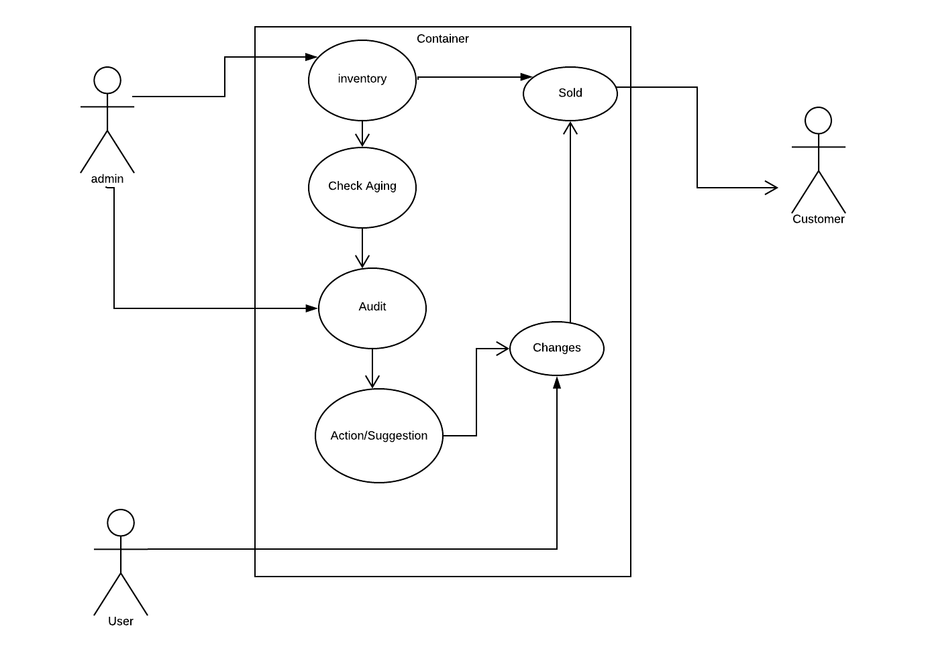
USECASE DIAGRAM

Slide 6
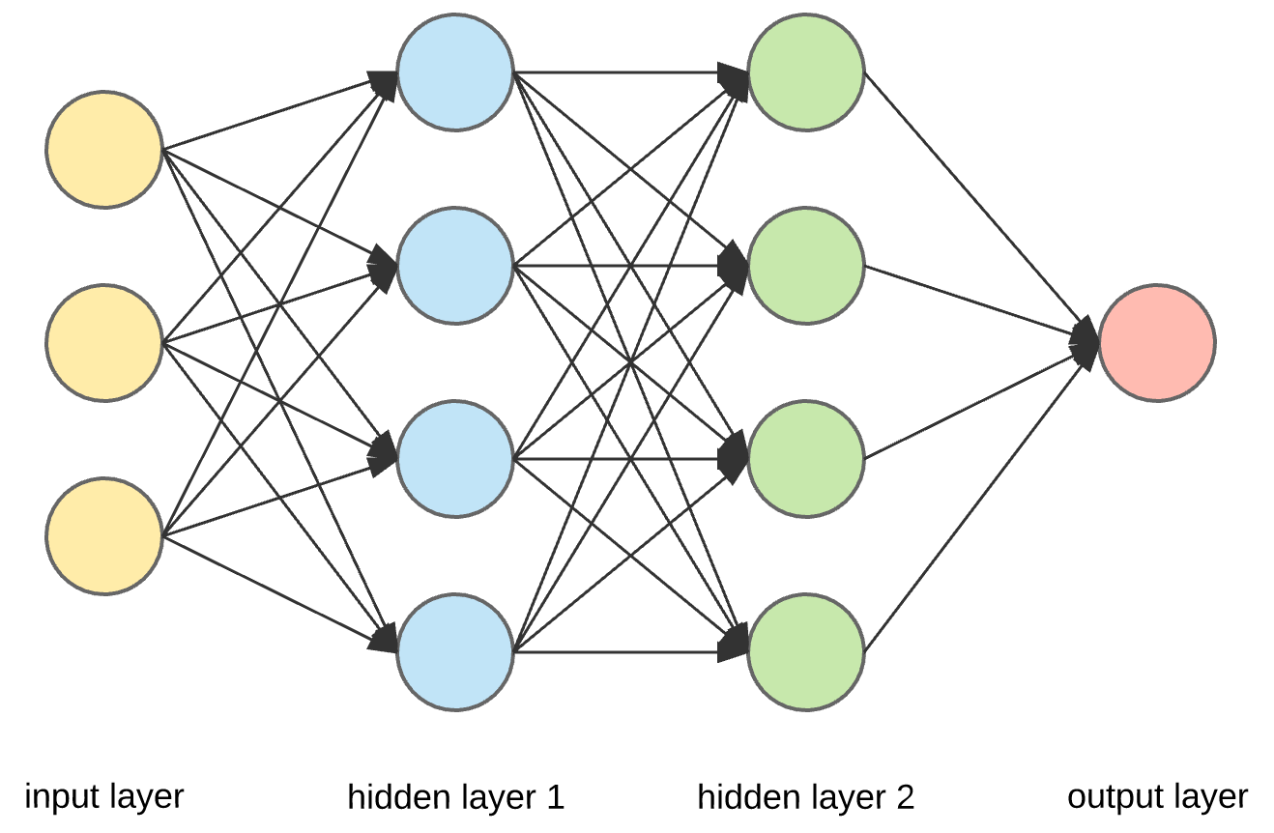
Neuron
weight
price
Gradient
3PL
location
Rating

Slide 7
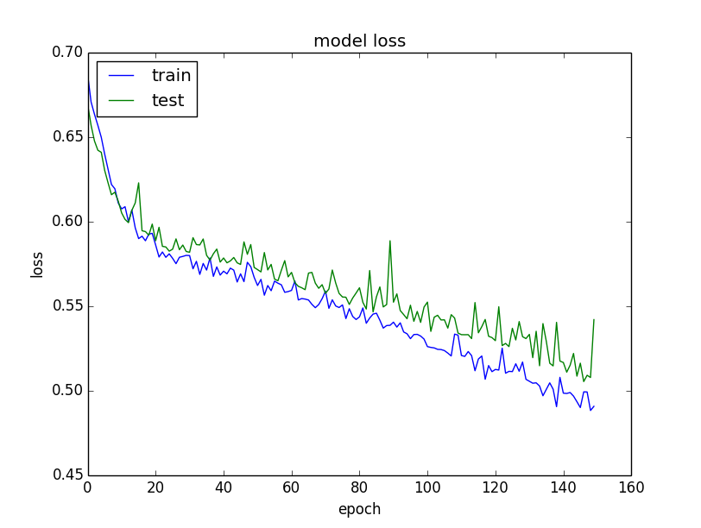

Slide 8
Technologies
Back-end: node.js
Database: MySQL
Front-End: HTML5/CSS/JS, Bootstrap, jQuery
ZeroRPC for Communication between server and Machine Learning code

Slide 9
Interface
Get an overview of all available items
Show the aging items and suggested actions
Ablility to move to a different 3PL, GDO or discard the item if it’s too old
Items highlighted according to their age
Suggested actions based on ML results from Python
Graphs and reports to let the user analyse past sales and make decisions

Slide 10
Thank You
Members:
Aditya Bose
Arshita Malhotra
Ayush Jindal
Satabdi Nayak

